Slide 1
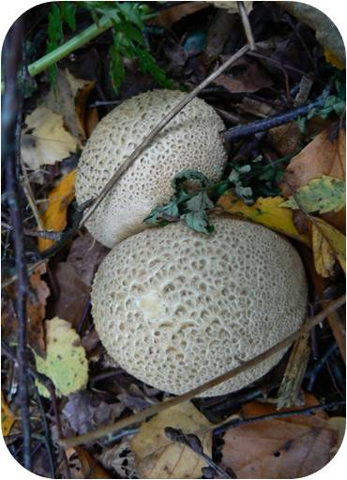
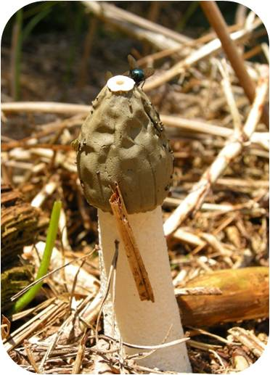
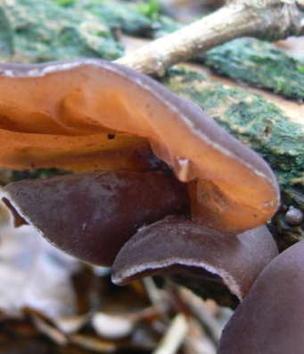
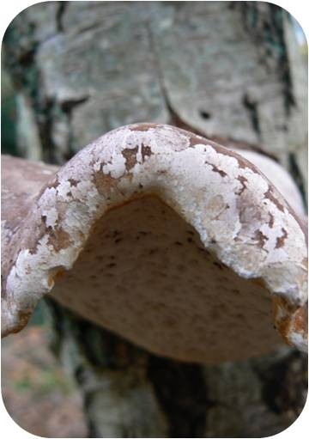
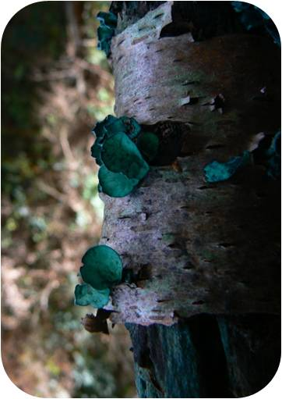
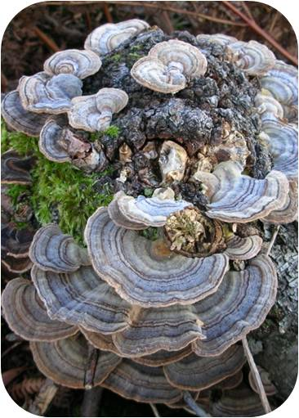
RSPB Pulborough Brooks Festival of Fungi – fungi top 21
Please remember that with so many different species in the UK, identification is not easy. Never eat any wild mushroom until an expert mycologist has checked your identification. Whilst I’ve labelled some of the fungi around our trail I am an enthusiast rather than an expert, and different species of fungi can pop up quickly next to an existing sign!
If you’ve enjoyed our fungi trail, please consider making a donation to support our conservation work on the wooded heath – you’ll find a donation cairn at the Visitor Centre.
Common earthball
Stinkhorn
Conifercone cap
If you break these open they smell strongly of rubber. You will find these all over the wooded heathland trail.
This starts of as a jelly-filled ball known as a witches’ egg! Use your nose to find these.
Look amongst the cones on the woodland floor to find these small fungi.
Jelly ear
Birch polypore
Hairy curtain crust
These jelly-like fungi really do look like ears! Grows on old or dead elder. Used in Chinese cooking!
Also known as razorstrop fungus - it was used to sharpen razor blades! Look on birch trees.
This fungus forms tough, leathery brackets. The margins are wavy and lobed and the surface hairy.
Green elf cup
Stags horn or candlesnuff
Turkeytail
The cups themselves are tiny but the fungus stains whole sections of wood green. Look on the ground for dead branches.
This one grows on dead wood so look out on any tree stumps you spot.
A multicoloured bracket fungi that grows on tree stumps. Potential for use in cancer treatment is being researched.

Slide 2
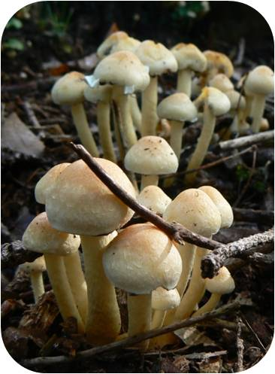
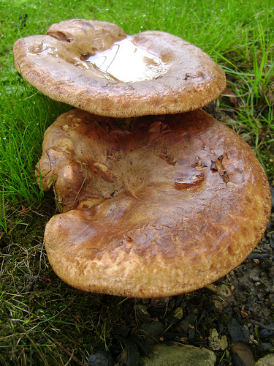
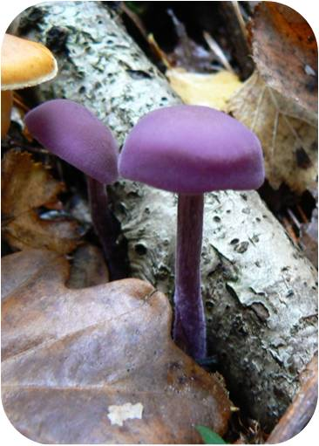
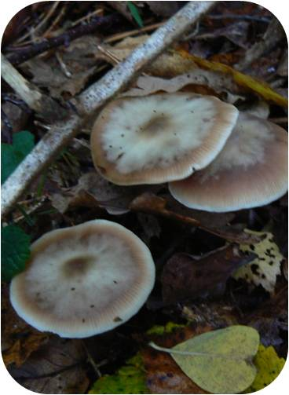
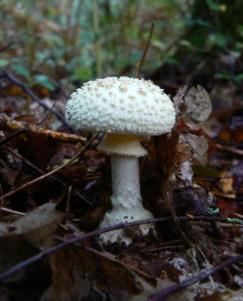
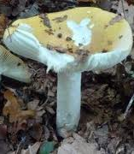
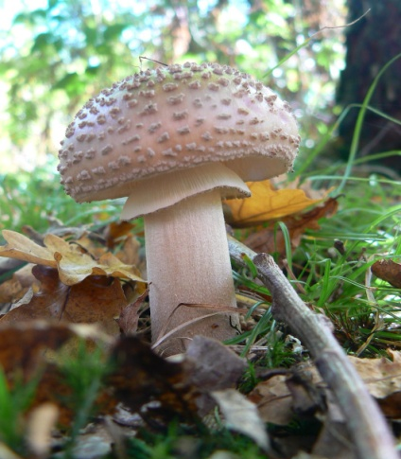
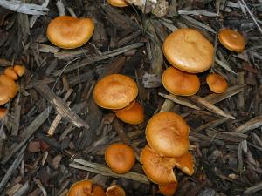
Sulphur tuft
Brown rollrim
Amethyst deceiver
Often found in clumps growing on dead wood, this yellow mushroom has a purple spore print.
Very poisonous – can be deadly. Viscid when wet – yuk! You can see these growing alongside the woodland tracks.
A beautiful purple mushroom - search amongst the leaf litter around the trail.
Butter cap
Snapping bonnet
False death cap
The cap feels greasy and ‘buttery’ – hence the name! The dark central peak (or umbo) is distinctive.
There are lots of different types of bonnet fungi – or Mycena. This one is often attached to dead twigs. The stem is springy and will ‘snap back’ if bent.
.
Smells like raw potato! Not poisonous but easily mistaken! Look alongside the trail through black wood.
Tawny Grisette
Ochre brittlegill
The blusher
This mushroom starts off egg-shaped but soon flattens out into an umbrella shape. Can you see the grooves on the edge of the cap?
Like the rest of the brittlegill family, the stem and gills of this mushroom are bright white and brittle.
In the same family – the Amanitas – as the famous fly agaric, but it is not quite so toxic! The flesh and stem go pink if they are bruised – hence the name.
Clouded funnel
The deceiver
Common rustgill
The cloudy grey caps can grow up to 20 cm in diameter! They often grow in rings or troops.
This one can be a bit tricky as the name suggests. The colour changes depending on how old it is and whether it is wet or dry
You should see plenty of these rusty-spored mushrooms amongst the conifer debris.

